Slide 1
Matrices Mathematical Induction
Course Code: CSC 1204
Course Title: Discrete Mathematics
Dept. of Computer Science
Faculty of Science and Technology
Lecturer No: | 11 | Week No: | 6 | Semester:
Lecturer: | Name & email

Slide 2
Lecture Outline
3.8 Matrices
Definition
Notation
Arithmetic Operations of Matrices
Boolean Operations of Matrices
4.1 Mathematical Induction
Proof by Mathematical Induction

Slide 3
Objectives and Outcomes
Objectives: To understand matrix and matrix notation, to perform arithmetic and Boolean operations of matrices, to prove by mathematical induction.
Outcomes: Students are expected to be able explain matrix and matrix notations; be able to perform arithmetic and Boolean operations of matrices; be able to prove a formula or inequality using mathematical induction.

Slide 4
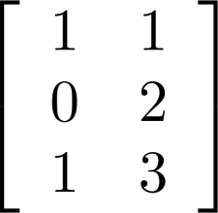
Matrices
Definition 1: A matrix is a rectangular array of numbers. A matrix with m rows and n columns is called an m× n matrix.
The plural of matrix is matrices
A matrix with the same number of rows as columns is called a square (or square matrix)
Two matrices are equal if they have the same number of rows and the same number of columns and the corresponding entries in every position are equal.
Example 1: The matrix
is a 3× 2 matrix.

Slide 5
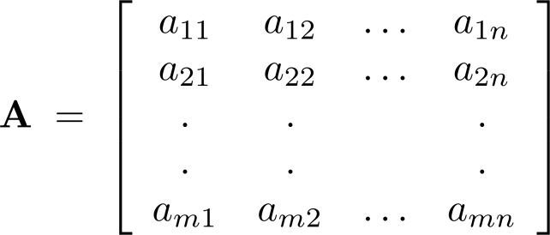
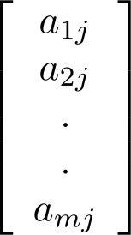
Notation
Let m and n be positive integers and let
The i th row of A is the 1× n matrix [a_{i1}, a_{i2},…,a_{in}]. The j th column of A is the m× 1 matrix:
The (i, j)th element or entry of A is the element a_{ij}.
We can use A = [a_{ij} ] to denote the matrix with its (i,j)th element equal to a_{ij}.

Slide 6
Matrix Arithmetic : Addition and Subtraction
The sum of two matrices of the same size is obtained by adding elements in the corresponding positions.
The subtraction of two matrices of the same size is obtained by subtracting elements in the corresponding positions
Only matrices with the same dimensions can be added and subtracted. The resulting matrix has the same dimension of the two matrices being added or subtracted.
Note: Matrices of different sizes cannot be added/subtracted

Slide 7
Addition of two Matrices
Definition 3: Let A = [a_{ij}] and B = [b_{ij}] be m× n matrices. The sum of A and B, denoted by A + B, is the m× n matrix that has a_{ij} + b_{ij} as its (i,j)th element.
In other words , A + B = [a_{ij} + b_{ij}]

Slide 8
Example
Add the corresponding elements in each matrix

Slide 9
Example 2 (p. 258)

Slide 10
Product of two Matrices
Definition 4: Let A be m× k matrix and B be k× n matrix. The product of A and B, denoted by AB, is the m× n matrix with its (i,j)th element equal to the sum of the products of the corresponding entries from the ith row of A and the jth column of B.
In other words, If AB = [c_{ij}], then c_{ij} = a_{i1}b_{1j} + a_{i2}b_{2j} +…+ a_{ik}b_{kj}.
Note: A product of two matrices is defined only when the number of columns in the first matrix equals the number of rows of the second matrix.

Slide 11
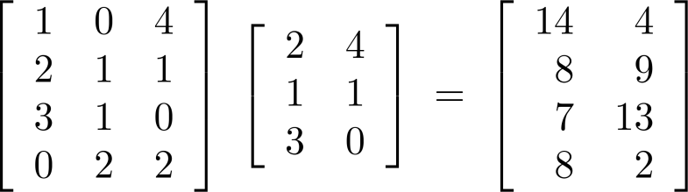
Example
Note: Here, we always multiply the row of first matrix by the column of the second matrix.
e.g. to find the element a_{3, 2}, multiply the third row of First matrix by the second column of Second matrix
a_{3, 2} = 3 1 0 * 4 = 3*4 + 1*1 + 0*0 = 13
1
0

Slide 12
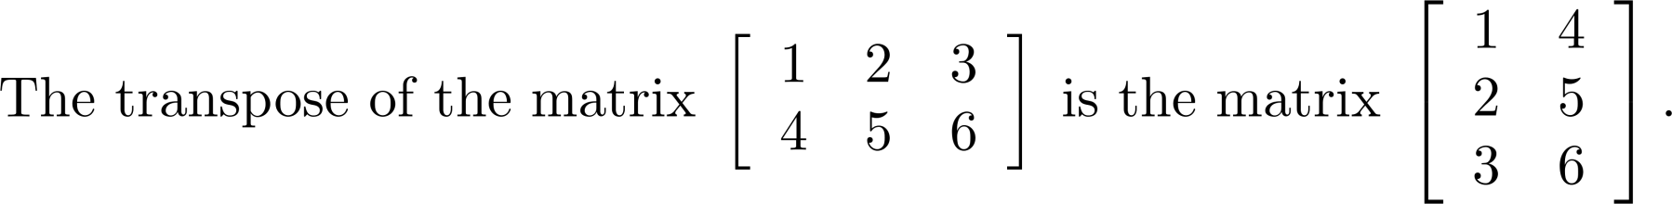
Transpose of a Matrix
Definition: Let A = [a_{ij}] be an m x n matrix. The transpose of A, denoted by A^{t}, is the n x m matrix obtained by interchanging the rows and columns of A.
If A^{t} = [ b_{ij} ], then b_{ij} = a_{ji} for i = 1, 2,…,n and j = 1, 2, ...,m.
Example 7

Slide 13
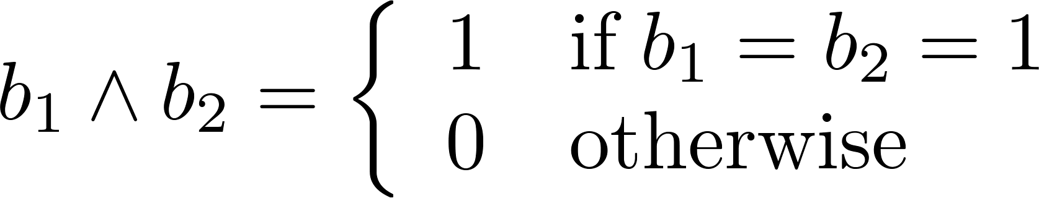
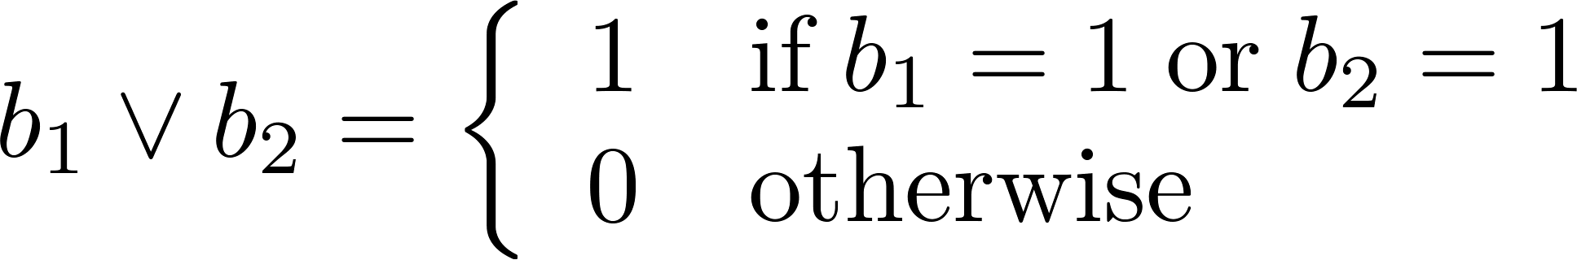
Zero-One Matrices
Definition: A matrix with entries that are either 0 or 1 is called zero-one matrix.
Algorithms operating on discrete structures represented by zero-one matrices are based on Boolean arithmetic defined by the following Boolean operations:

Slide 14
Join and Meet of Zero-One Matrices
Definition: Let A = [a_{ij}] and B = [b_{ij}] be an m × n zero-one matrices.
The join of A and B is the zero-one matrix with (i,j)th entry a_{ij} ∨ b_{ij}. The join of A and B is denoted by A ∨ B.
The meet of of A and B is the zero-one matrix with (i,j)th entry a_{ij} ∧ b_{ij}. The meet of A and B is denoted by A ∧ B.
Note: These operations(join and meet) are only possible when A and B have the same size, just as in the case of matrix addition.

Slide 15
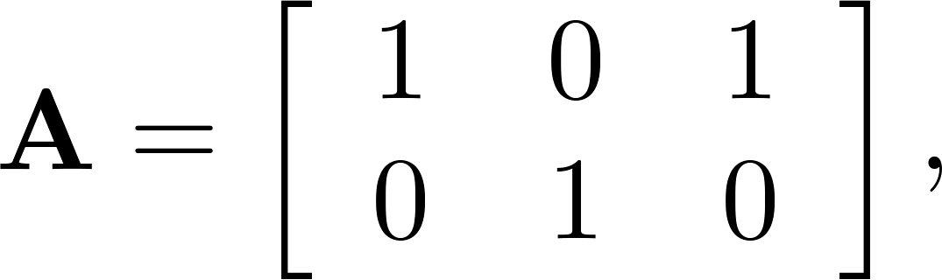
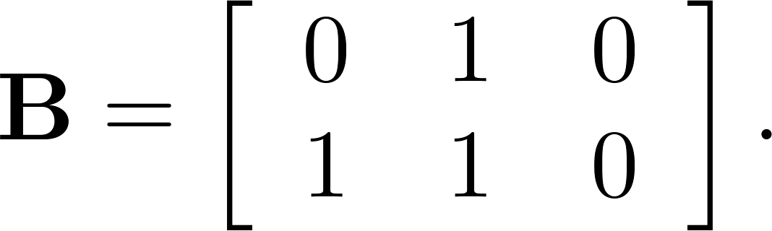
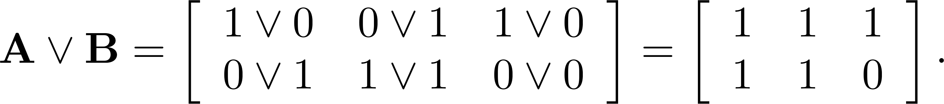
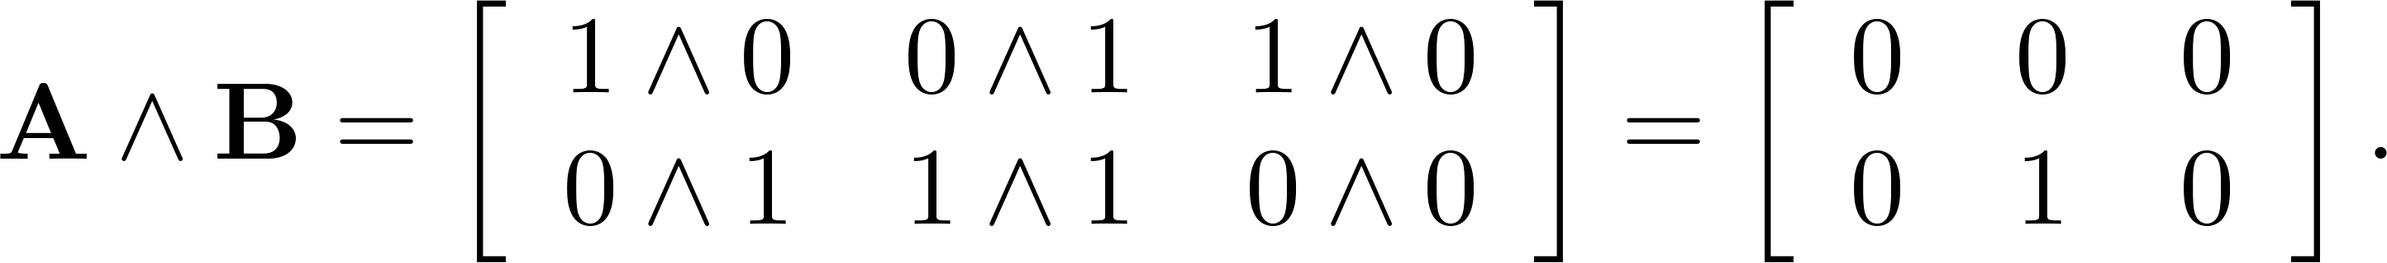
Example 9 (p. 262)
Find the join and meet of the zero-one matrices
Solution: The join of A and B is
The meet of A and B is

Slide 16
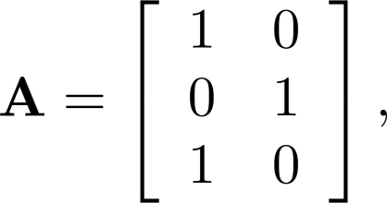
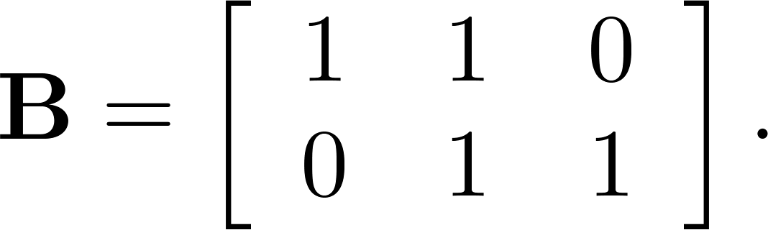
Boolean Product of Zero-One Matrices
Definition: Let A = [a_{ij}] be an m× k zero-one matrix and B = [b_{ij}] be a k× n zero-one matrix. The Boolean product of A and B, denoted by A ⊙ B, is the m× n zero-one matrix with(i,j)th entry c_{ij} where c_{ij} = (a_{i1} ∧ b_{1j})∨ (a_{i2} ∧ b_{2j}) ∨ … ∨ (a_{ik} ∧ b_{kj})
Example 9 (p.262): Find the Boolean product of A and
B, where

Slide 17
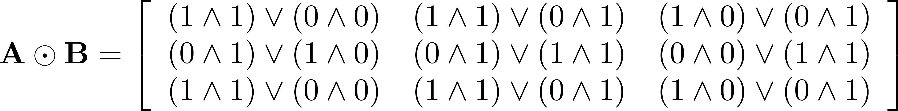
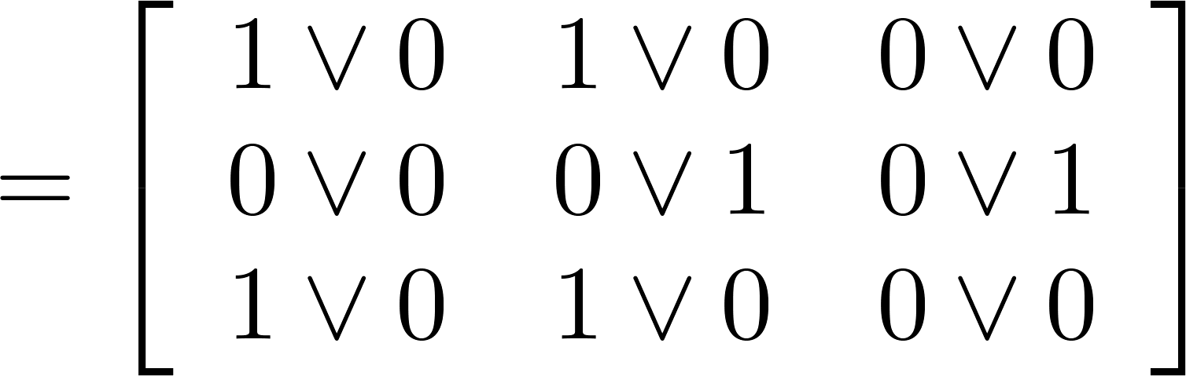
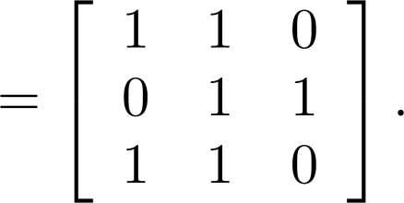
Solution of Example 9
The Boolean product A ⊙ B is given by

Slide 18
4.1 Mathematical Induction
Suppose that we have an infinite ladder, and we want to know whether we can reach every step on this ladder.
We know two things –
We can reach the first rung of the ladder
If we can reach a particular rung of the ladder, then we can reach the next rung
Can we conclude that we can reach every rung?

Slide 19
4.1 Mathematical Induction
By (1), we know that we can reach the first rung of the ladder. Moreover, because we can reach the first rung, by (2), we can also reach the second rung; it is the next rung after the first rung.
Applying (2) again, because we can reach the second rung, we can also reach the third rung.
Continuing in this way, we can show that we can reach the fourth rung, the fifth rung, and so on.
For example, after 100 uses of (2), we know that we can reach the 101st rung

Slide 20
4.1 Mathematical Induction
Can we conclude that we are able to reach every rung of this infinite ladder?
Answer: Yes.
We can verify using an important proof technique called mathematical induction
We can show that P(n) is true for every positive integer n, where P(n) is the statement that we can reach the nth rung of the ladder.

Slide 21
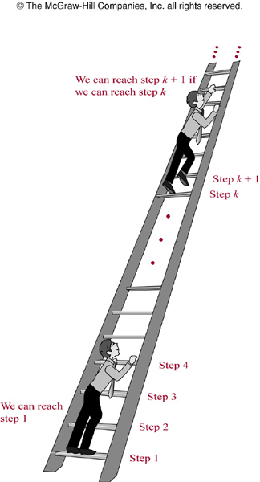
FIGURE 1 : Climbing an Infinite Ladder

Slide 22
Ways to Remember How Mathematical Induction Works
E.g.
− Climbing an infinite ladder
− People telling secrets
− Infinite row of dominoes

Slide 23
Mathematical Induction
Mathematical induction is an extremely important proof technique that can be used to prove assertions of this type.
Mathematical induction is used extensively to prove results about a large variety of discrete objects.
For example, it is used to prove results about the complexity of algorithms, the correctness of certain types of computer programs, theorems about graphs and trees, as well as a wide range of identities and inequalities

Slide 24
Mathematical Induction
Mathematical induction can be used only to prove results obtained in some other way. It is not a tool for discovering formulae or theorems.
The principle of mathematical induction is a useful tool for proving that a certain predicate is true for all natural numbers
It cannot be used to discover theorems, but only to prove them

Slide 25
Mathematical Induction
Principle of Mathematical Induction: To prove that P(n) is true for all positive integers n, where P(n) is a propositional function, we complete two steps:
BASIS STEP: We verify that P(1) is true.
INDUCTIVE STEP : We show that the conditional statement P(k) → P(k+1) is true for all positive integers k
Inductive hypothesis: P(k) is true
[ P(1) ∧ ∀k(P(k) → P(k+1))] → ∀n P(n)

Slide 26
Example 1
Show that if n is a positive integer, then 1 + 2 + ………. + n = n(n+1)/2
Solution: Let P(n) be the proposition that the sum of the first n positive integers is n(n+1)/2.
We must do two things to prove that P(n) is true for n = 1, 2, 3, ….. Namely, we must show that P(1) is true and that the conditional statement P(k) implies P(k+1) is true for k = 1, 2, 3,
BASIS STEP: P(1) is true, because 1 = 1(1+1)/2
INDUCTIVE STEP: For the inductive hypothesis, we assume that P(k) holds for an arbitrary positive integer k. That is we assume that
1 + 2 + …..+ k = k(k+1)/2 ( INDUCTIVE HYPOTHESIS )

Slide 27
Example 1
Under this assumption, it must be shown that P(k+1) is true, namely, that
1 + 2 + ……+ k + (k+1) = (k+1)[(k+1)+1]/2 = (k+1)(k+2)/2 is also true.
Adding (k+1) to both sides of the equation in P(k), we obtain
1 + 2 + ……+ k + (k+1) = k(k+1)/2 + (k+1)
= [k(k+1) + 2(k+1)] / 2
= (k+1)(k+2)/2
This last equation shows that P(k+1) is true under the assumption that P(k) is true. This completes the inductive step.
We have completed the basis step and inductive step, so by mathematical induction we know that P(n) is true for all positive integers n. That is, we have proven that 1 + 2 + ….+ n = n(n+1)/2 for all positive integers n.

Slide 28
Example 3
Use mathematical induction to show that 1 + 2 + 2² + …..+ 2^{n} = 2^{n+1} –1 for all nonnegative integers n.
Solution: Let P(n) be the proposition that 1 + 2 + 2² + …..+ 2^{n} = 2^{n+1} –1 for the integer n.
BASIS STEP: P(0) is true because 2⁰ = 1 = 2¹ –1
INDUCTIVE STEP: For the inductive hypothesis, we assume that P(k) is true.
That is, we assume that 1 + 2 + 2² + …..+ 2^{k} = 2^{k+1} –1
To carry out the inductive step using this assumption, we must show that when we assume that P(k) is true, then P(k+1) is also true. That is we must show that
1 + 2 + 2² + …..+ 2^{k} + 2^{k+1}= 2^{(k+1)+1} –1 = 2^{k+2} –1 , assuming the inductive hypothesis P(k).

Slide 29
Example 3 (Cont.)
Under the assumption of P(k), we see that
1 + 2 + 2² + …..+ 2^{k} + 2^{k+1} = (1 + 2 + 2² + …..+ 2^{k} )+ 2^{k+1}
= (2^{k+1} –1 )+ 2^{k+1}
= 2. 2^{k+1} – 1
= 2^{k+2} – 1
Because we have completed the basis step and the inductive step, by mathematical induction we know that P(n) is true for all nonnegative integers n.
That is, 1 + 2 + 2² + …..+ 2^{n} = 2^{n+1} –1 for all nonnegative integers n.

Slide 30
Example 5
Example 5: Use mathematical induction to prove the inequality n < 2^{n} for all positive integers n.
Solution: Let P(n) be the proposition that n < 2^{n} .
BASIS STEP: P(1) is true, because 1 < 2¹ = 2
INDUCTIVE STEP: Assume P(k) is true for all positive integer k, that is, k < 2^{k} (Inductive Hypothesis)
We need to show that if k < 2^{k} , then k+1 < 2^{k+1}
Now, k + 1 < 2^{k} + 1 [adding 1 to both sides of k < 2^{k} ]
≤ 2^{k} + 2^{k} = 2. 2^{k} = 2^{k+1} [ note: 1 ≤ 2^{k} ]
This shows that P(k+1) is true, i.e., k+1 < 2^{k+1}
Because we have completed both the basis step and the inductive step, by the principle of mathematical induction we have shown that n < 2^{n} is true for all positive integers n.

Slide 31
(Modified )Exercise 3
Modified Exercise 3: Use mathematical induction to show that
1² + 2² + …..+ n² = n (n+1)(2n+1) / 6 for all positive integers n.
Solution: Let P(n) be the proposition 1² + 2² + …..+ n² = n (n+1)(2n+1)/6
BASIS STEP: P(1) is true, because 1² = 1.2.3/6
INDUCTIVE STEP: We assume that 1² + 2² + …..+ k² = k(k+1)(2k+1)/6 (Inductive Hypothesis)
We want to show that 1² + 2² + …..+ k² + (k + 1)²= (k+1)(k+2)(2k+3)/6
Now, 1² + 2² + …..+ k² + (k + 1)² = k(k+1)(2k+1)/6 + (k + 1)²
= (k+1)/6 [k(2K+1) + 6(K+1)]
= (k+1)/6 [2k² +7k + 6]
= (k+1)/6 [2k² + 4k + 3k+ 6]
= (k+1)/6 [2k² + 4k + 3k+ 6]
= (k+1)(k+2)(2k+3)/6 So, inductive step is tru.
Therefore, 1² + 2² + …..+ n² = n (n+1)(2n+1)/6 for all positive integers n.

Slide 32
Exercise 5
Exercise 5: Prove that 1² + 3² + 5² + …..+ (2n+1)² = (n+1)(2n+1)(2n+3)/3
whenever n is a nonnegative integer.
Solution: Let P(n) be the proposition 1² + 3² + 5² +…..+ (2n+1)² = (n+1)(2n+1)(2n+3)/3
BASIS STEP: P(0) is true, because 1² = 1.1.3/3
INDUCTIVE STEP: We assume that 1² + 3² + 5² + …..+ (2k+1)² = (k+1)(2k+1)(2k+3)/3 (Inductive Hypothesis)
We want to show that 1² + 3² + 5² + …..+ (2k+1)² + (2k+3)² = (k+2)(2k+3)(2k+5)/3
Now, (1² + 3² + 5² + …..+ (2k+1)² ) + (2k+3)² = (k+1)(2k+1)(2k+3)/3 + (2k+3)²
= (2k+3)/3 [ (k+1)(2k+1) + 3(2k+3) ]
= (2k+3)/3 [ (2k² + 3k + 1) + (6k + 9)]
= (2k+3)/3 [ 2k² + 9k + 10 ]
= (2k+3)/3 [2k² + 4k + 5k + 10 ] = (2k+3)/3 [2k(k+2) + 5(k+2)]
= (k+2)(2k+3)(2k+5)/3
Therefore inductive step is true
So, 1² + 3² + 5² + …..+ (2n+1)² = (n+1)(2n+1)(2n+3)/3, whenever n is a nonnegative integer

Slide 33
Practice @ Home
Relevant odd-numbered Exercises from your text book

Slide 34
Books
Discrete Mathematics and its applications with combinatorics and graph theory (7th edition) by Kenneth H. Rosen [Indian Adaptation by KAMALA KRITHIVASAN], published by McGraw-Hill

Slide 35
References
Discrete Mathematics, Richard Johnsonbaugh, Pearson education, Inc.
Discrete Mathematical Structures, Bernard Kolman, Robert C. Busby, Sharon Ross, Prentice-Hall, Inc.
SCHAUM’S outlines Discrete Mathematics(2nd edition), by Seymour Lipschutz, Marc Lipson

